Slide 1
Lending Case Study
Introduction
The aim of the case study is to bring out the meaningful information from the data containing information on the loan disbursed by the Banking Organization.
To implement the changes we will implement following EDA (Exploratory Data Analysis) techniques.
Data Sourcing and Cleansing
Univariate Analysis
Bivariate Analysis
Derived Analysis
Prepared by:- Dinesh Kumar

Slide 2
Data Sourcing and Cleansing
Columns 58-78 were deleted since all rows contained only “NA” values and holds no relevance.
Columns issue_d and earliest_cr_line were converted to Date with Day, month and Year.
Column total_pymnt numeric values were round to 2 decimals only
emp_title column contained null values which were converted to as “Not Available”
Prepared by:- Dinesh Kumar

Slide 3
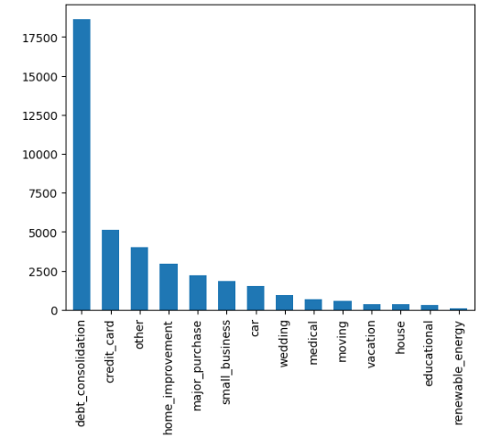
Categorical Univariate Analysis -1
Use Case 1
Description – The study was done on the purpose of the loan to know the intention of taking a loan. Single column “purpose” was taken for this.
Conclusion – Results shows that maximum people take loan for debt consolidation followed by credit card payment which is concern as there are higher chances of people not paying the loan amount.

Slide 4
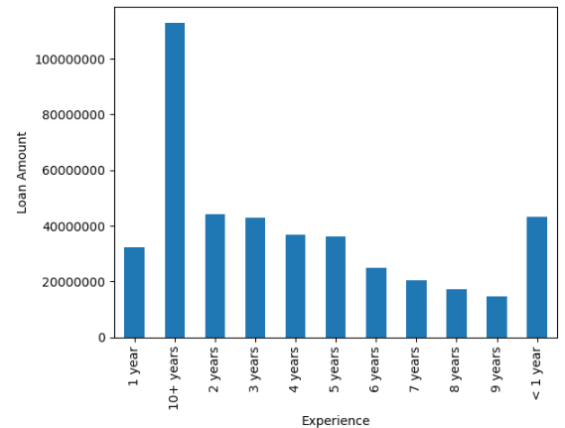
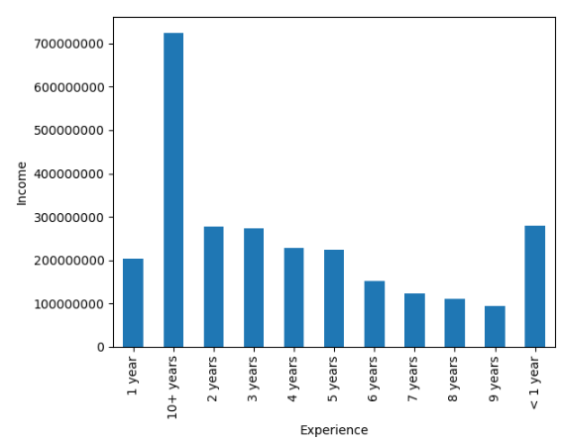
Categorical Univariate Analysis -2
Use Case 2
Description – The Analysis was done on the loan amount funded per Borrower Experience
Conclusion – Results show that people with 10+ experience has more salary and the loan amount as compared to people with 9years and there are few people having 9years experience. Check both Graphs.

Slide 5
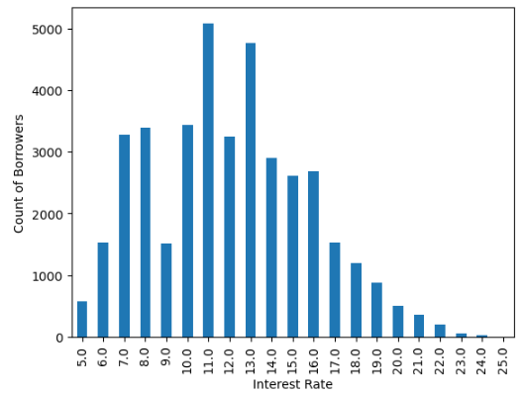
Categorical Univariate Quantitative Analysis
Use Case - Categorical Univariate Quantitative Analysis
Description – The Analysis was done on the different interest rates charged to the Customer.
Conclusion – Results show that most frequent interest rate paid is in 11% category and there are few borrowers which pay interest more than 16%. Bank can focus on increasing such customers so as to increase the profit.

Slide 6
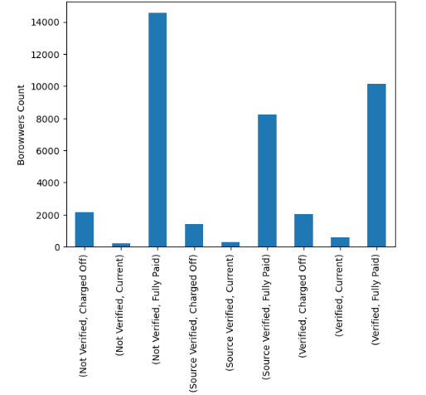
Segmented Univariate Analysis-1
Use Case 1 - Loan Status based on the Income Verification Status
Description – The Analysis was done on the Loan Status based on the Income Verification Status.
Conclusion – Borrowers Count who defaulted the loan are more in numbers in "Not Verified" category as compared to the ones who are in "Source Verified Category“. We will see the amount which is funded to such categories in Use Case2.

Slide 7
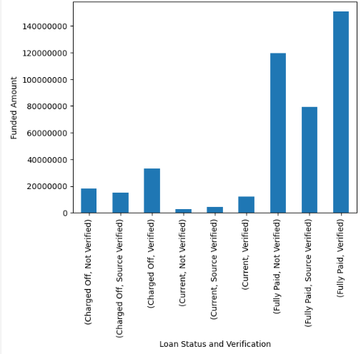
Segmented Univariate Analysis-2
Use Case 2 - Funded Amount based on the Income Verification Status and Loan Status
Description – The Analysis was done on the Funded Amount based on the Income Verification Status and Loan Status.
Conclusion – Amount funded to the Borrowers who are defaulters or charged off is less compared to the ones who have fully paid the loan but
if we compare the defaulters based on the Verification Status I see the verified ones have more share of the funded amount
which is a case of concern.

Slide 8
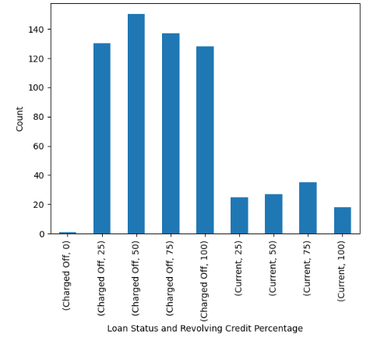
Derived Metrics
Use Case 2
Description – The Analysis was done to find out the customers who have higher chance of not paying the loan amount or becoming defaulters..
Conclusion - Case having Higher Revolving Credit percentage has more probability of Defaulting the Loan. As it can seen in the Charged off category that people who were using the revolving credit charged off.

Slide 9
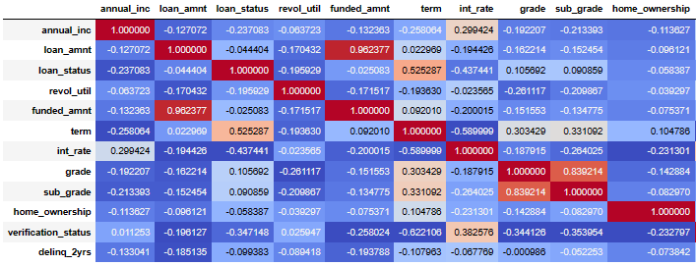
Bivariate Analysis
Description – Bivariate Analysis was done on multiple columns to check if there was any correlation between them.
Conclusion - Finding 1 - Loan term has correlation with the Loan status. People taking loan for small tenure default less
Finding 2 - Loan Amount and Funded amount is 0.96 correlated which means people are getting most of the requested loan amount irrespective of the verification status

